Slide 1
Learning ASP.NET Core IdentityServer

Slide 2
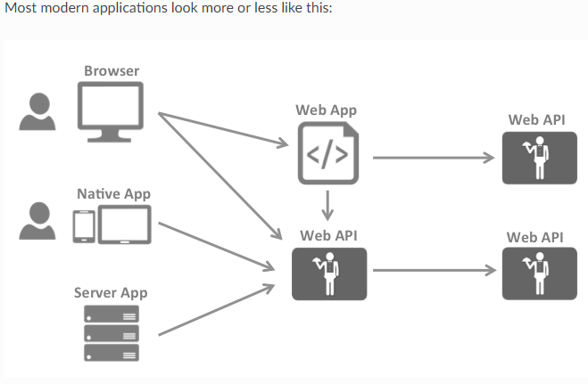
Typically each and every layer (front-end, middle-tier and back-end) has to protect resources and implement authentication and/or authorization – often against the same user store.
Outsourcing these fundamental security functions to a security token service prevents duplicating that functionality across those applications and endpoints.

Slide 3
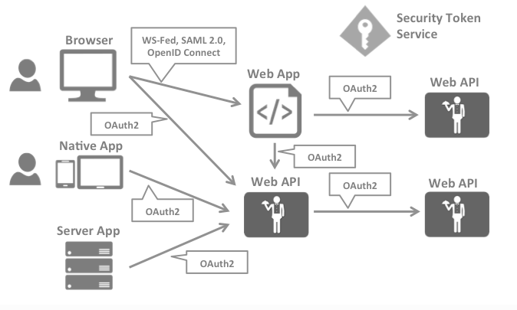

Slide 4
Applications have two fundamental ways with which they communicate with APIs – using the application identity, or delegating the user’s identity. Sometimes both methods need to be combined.
OAuth2 is a protocol that allows applications to request access tokens from a security token service and use them to communicate with APIs. This delegation reduces complexity in both the client applications as well as the APIs since authentication and authorization can be centralized.

Slide 5
What is IdentityServer?
It’s AAAS
Authentication as a Service

Slide 6
IdentityServer is designed for flexibility and part of that is allowing you to use any database you want for your users and their data (including passwords).
If you are starting with a new user database, then ASP.NET Identity is one option you could choose.
IdentityServer4 is an OpenID Connect and OAuth 2.0 framework for ASP.NET Core 2.
It enables the following features in your applications:
Authentication as a Service: Centralized login logic and workflow for all of your applications (web, native, mobile, services). IdentityServer is an officially certified implementation of OpenID Connect.
Single Sign-on / Sign-out: Single sign-on (and out) over multiple application types.
Access Control for APIs: Issue access tokens for APIs for various types of clients, e.g. server to server, web applications, SPAs and native/mobile apps.
Federation Gateway: Support for external identity providers like Azure Active Directory, Google, Facebook etc. This shields your applications from the details of how to connect to these external providers.
Focus on Customization: The most important part - many aspects of IdentityServer can be customized to fit your needs. Since IdentityServer is a framework and not a boxed product or a SaaS, you can write code to adapt the system the way it makes sense for your scenarios.

Slide 7
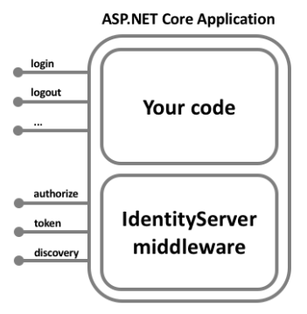
How IdentityServer4 can help?
IdentityServer is middleware that adds the spec compliant OpenID Connect and OAuth 2.0 endpoints to an arbitrary ASP.NET Core application.
Typically, you build (or re-use) an application that contains a login and logout page (and maybe consent - depending on your needs), and the IdentityServer middleware adds the necessary protocol heads to it, so that client applications can talk to it using those standard protocols.

Slide 8
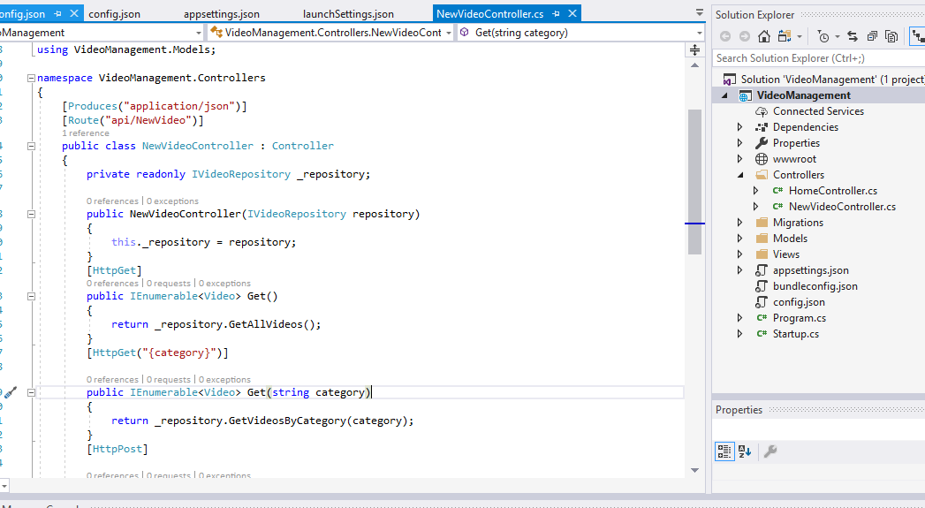
We already have Video Management Project With API

Slide 9
Now we will associate IdentityServer4 with this API

Slide 10
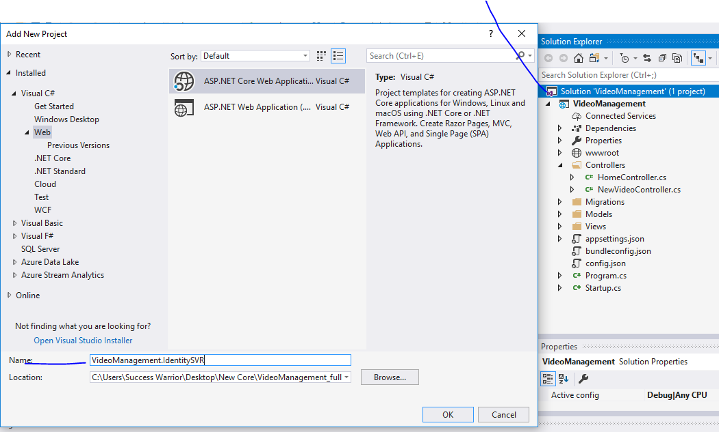
In same solution add new project

Slide 11
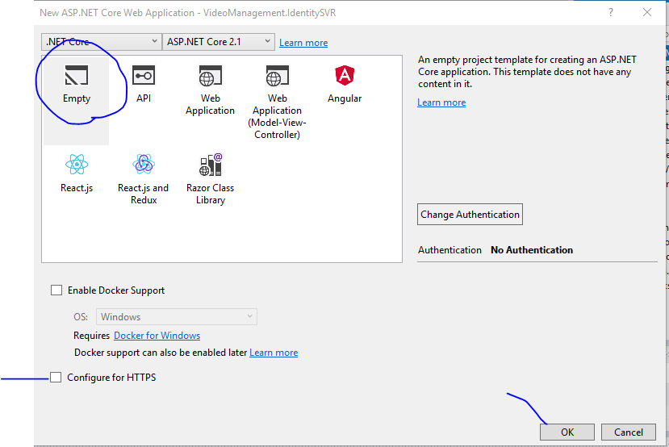

Slide 12
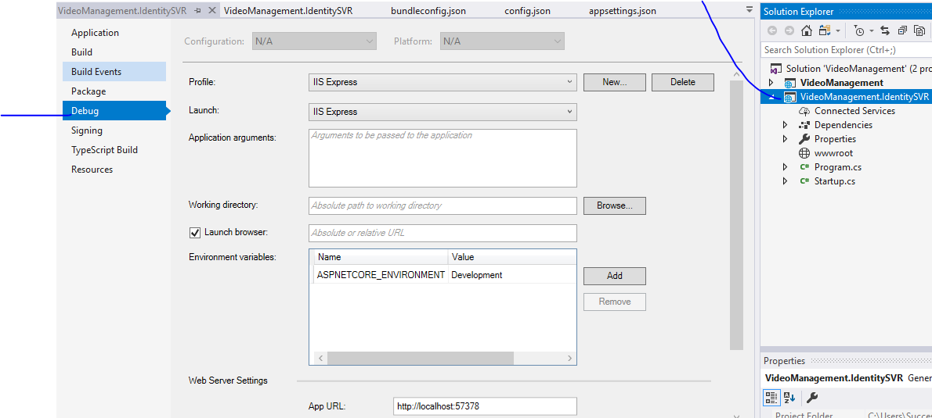
Go to properties and then debug tab

Slide 13
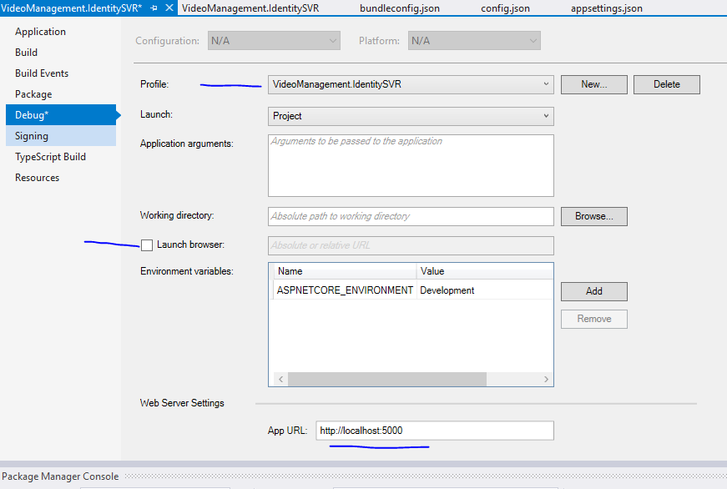
Change and SAVE

Slide 14
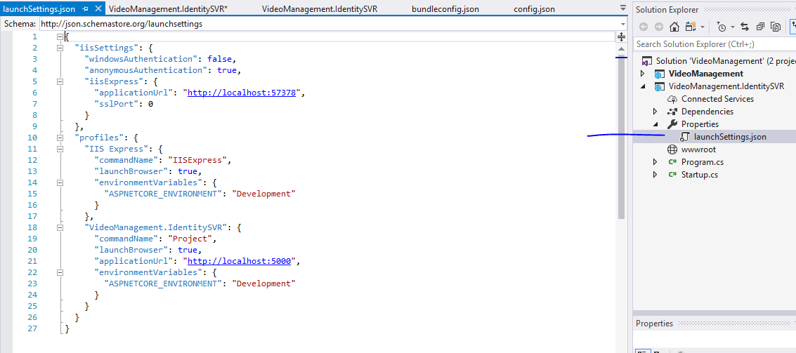
You will get launchsettings like this

Slide 15
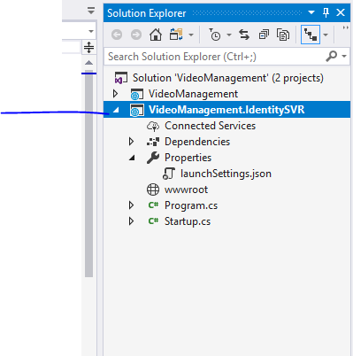
Set this project as
Startup project

Slide 16
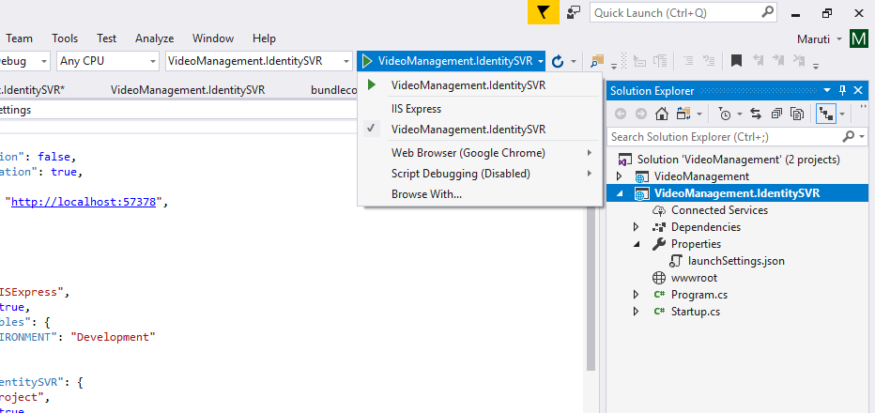
Select this and run to hit console

Slide 17
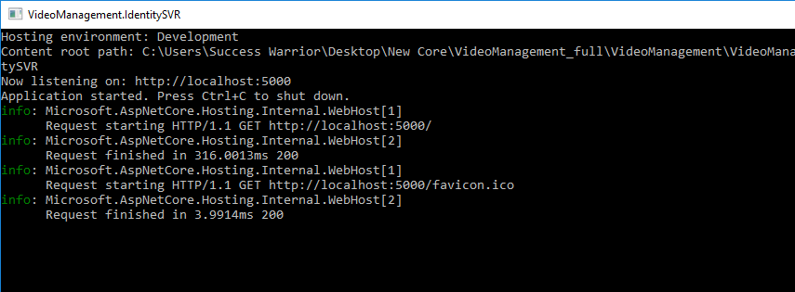

Slide 18
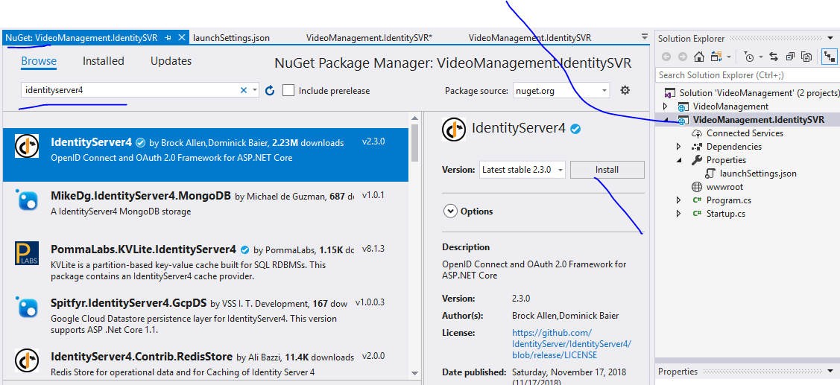

Slide 19
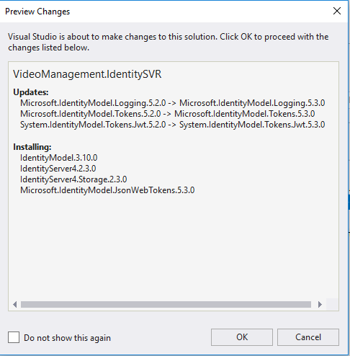

Slide 20
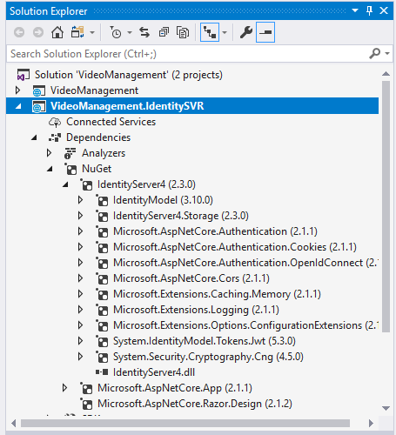
You will get all this

Slide 21
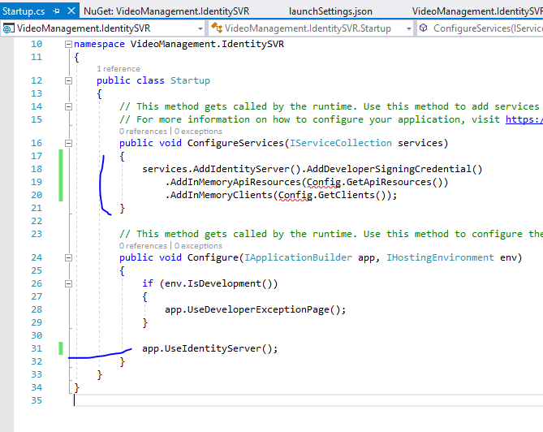
We will
Create these
Two methods

Slide 22
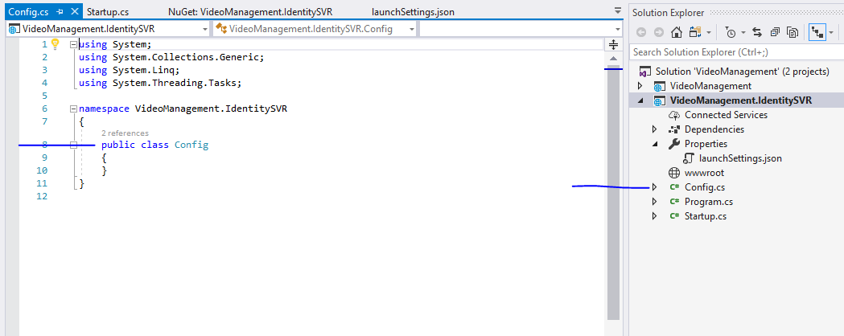
Add new class

Slide 23
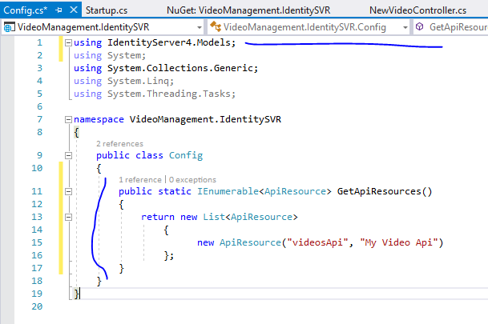

Slide 24
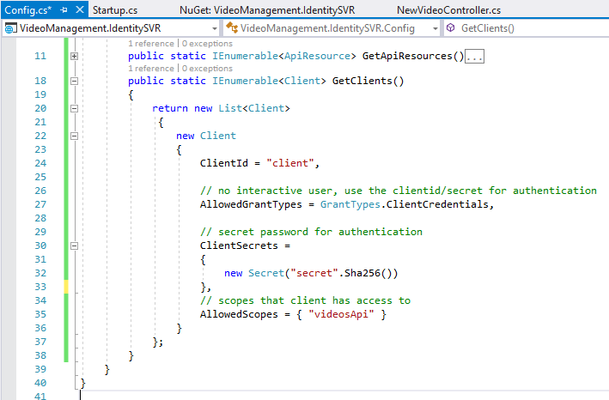

Slide 25
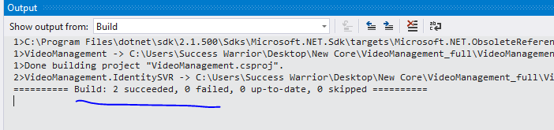

Slide 26
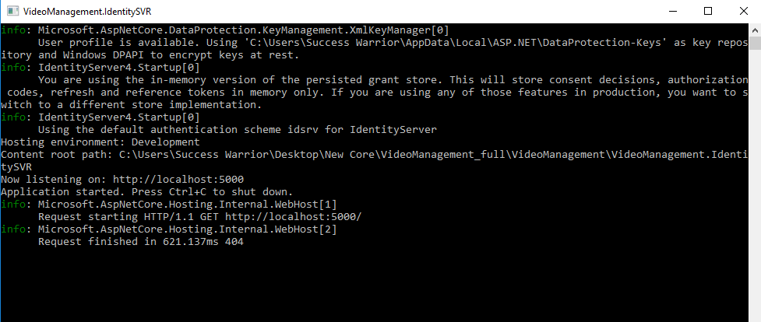

Run this server project in console and you will get something like this

Slide 27
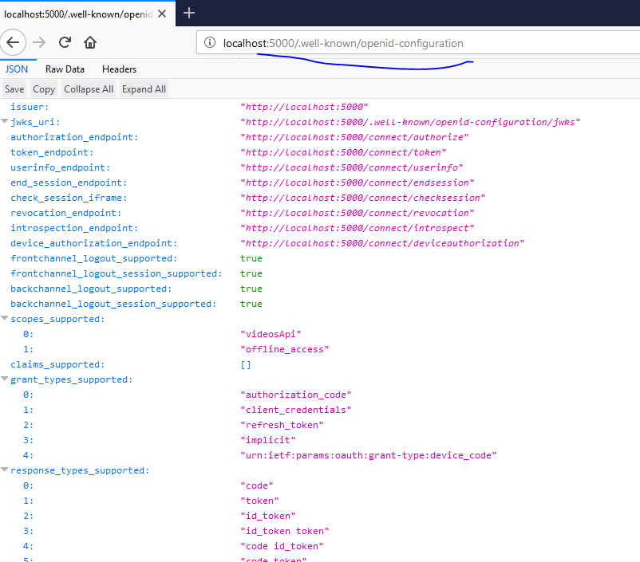
Open in firefox
If chrome shows
Non formatted
json

Slide 28
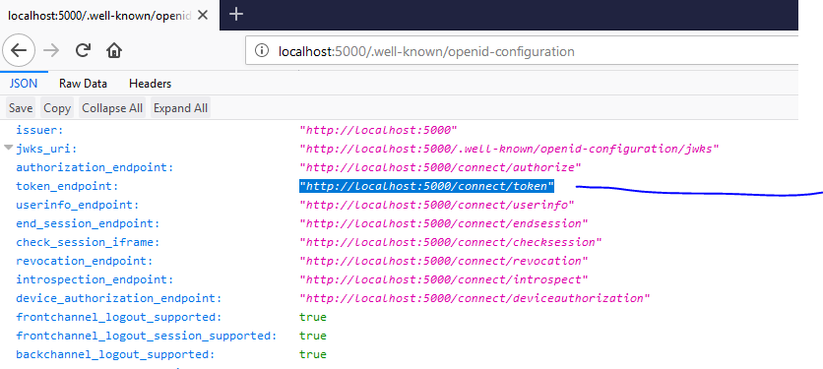
Now we are going to use this in
Postman

Slide 29
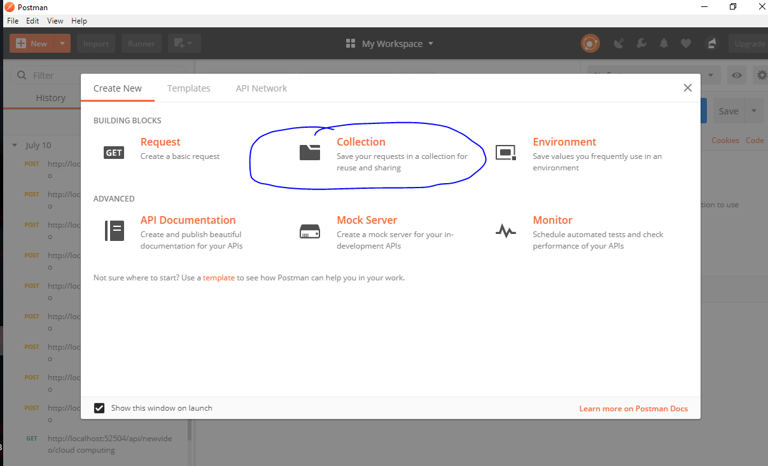

Slide 30
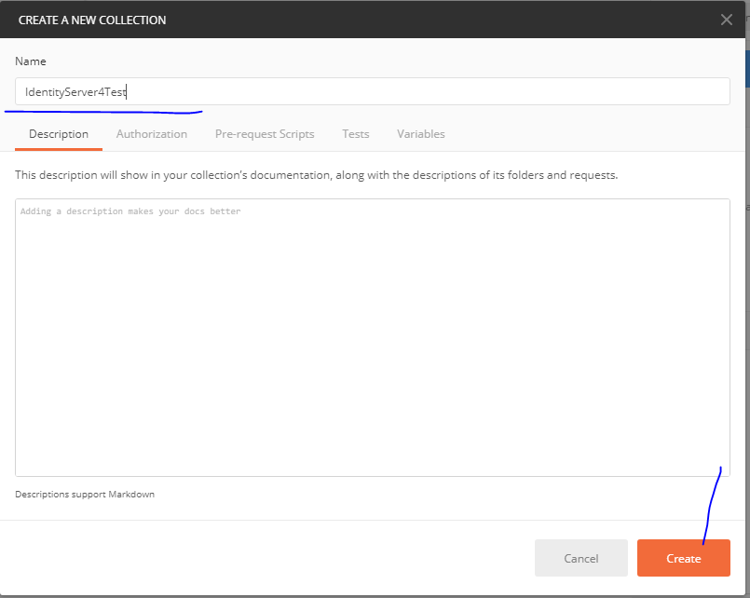

Slide 31
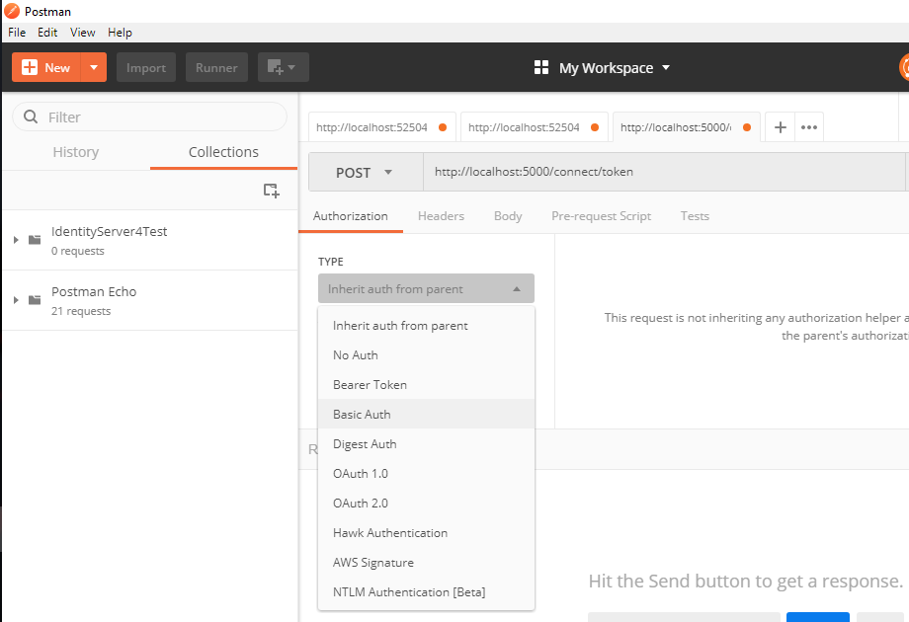

Slide 32
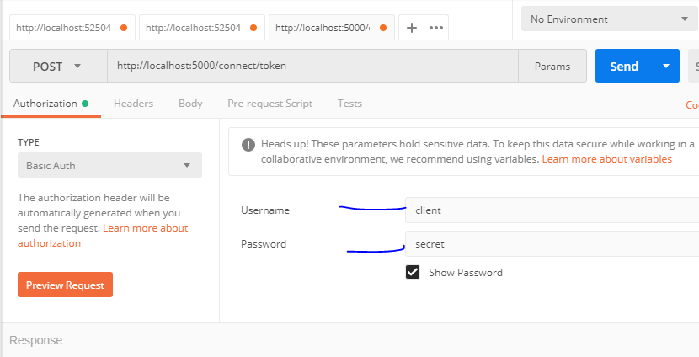

Slide 33
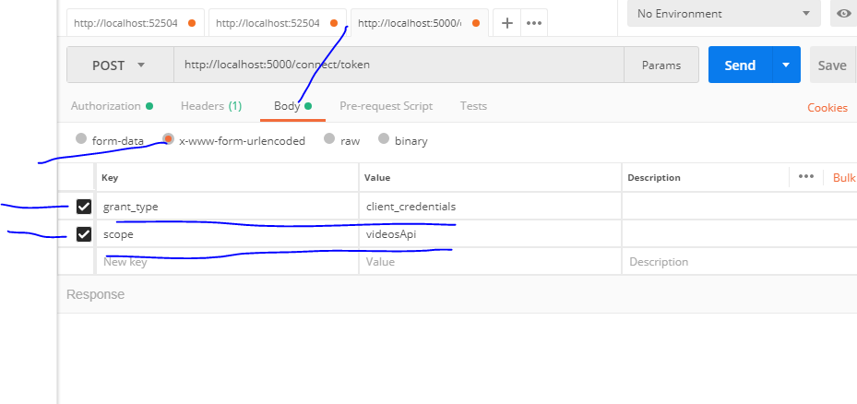
As per code written in config.cs

Slide 34
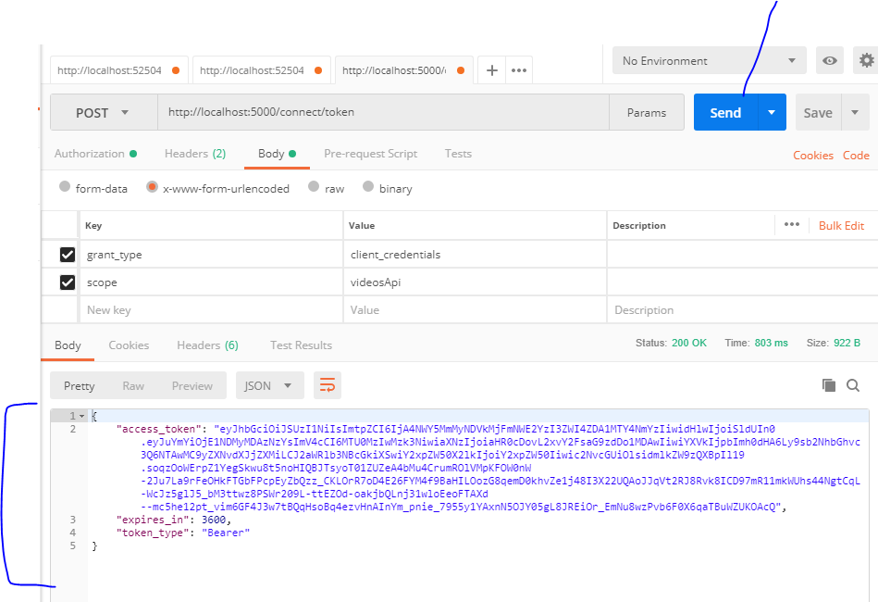
Click on send and you will receive access_token which is valid for next one hour

Slide 35
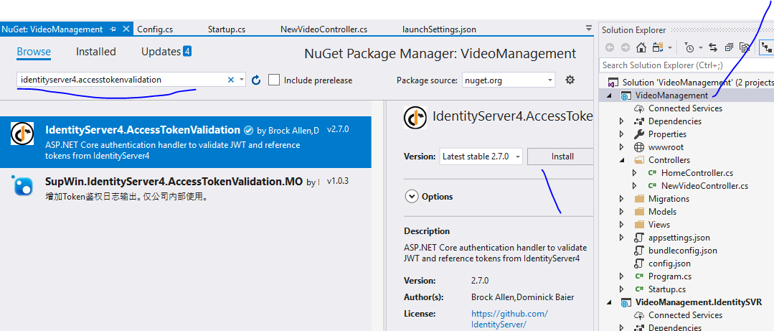

Slide 36
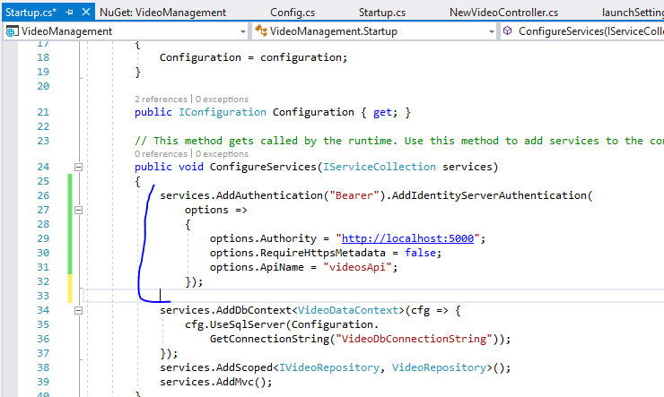

Slide 37
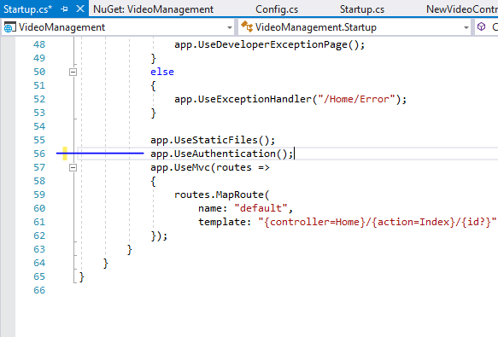

Slide 38
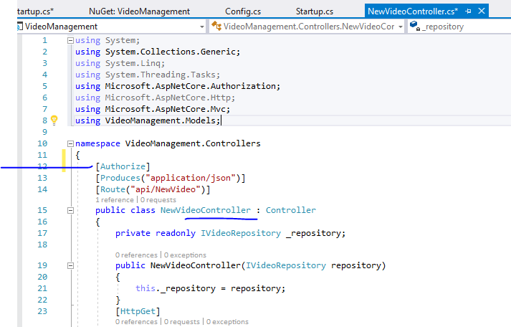

Slide 39
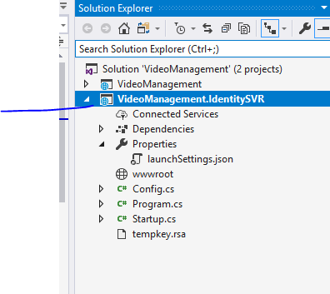
Set as startup project

Slide 40
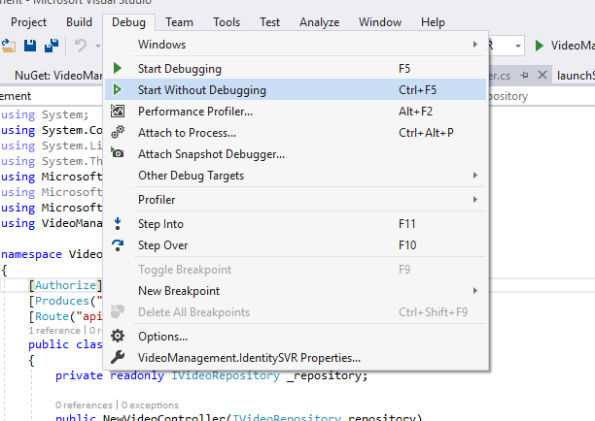

Slide 41
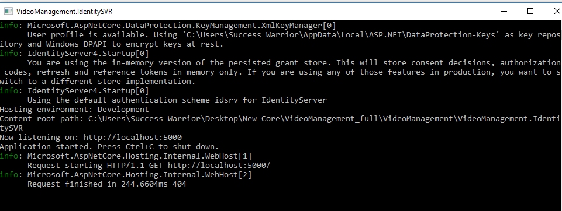

Slide 42
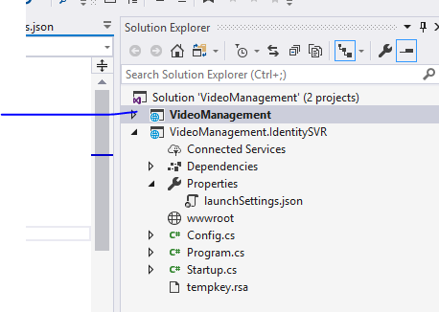
Set as startup project

Slide 44
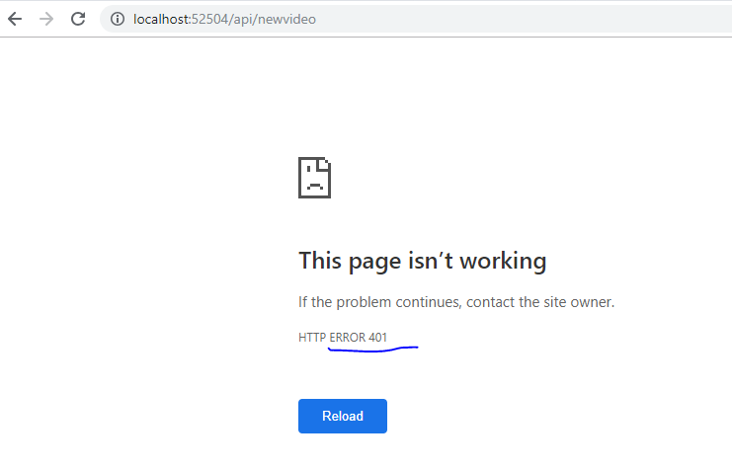
401 means unauthorized

Slide 45
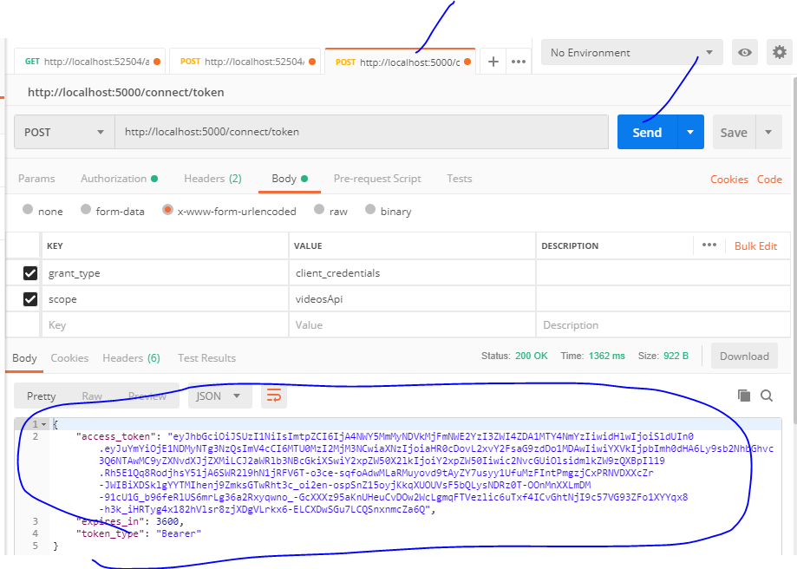
Copy
token

Slide 46
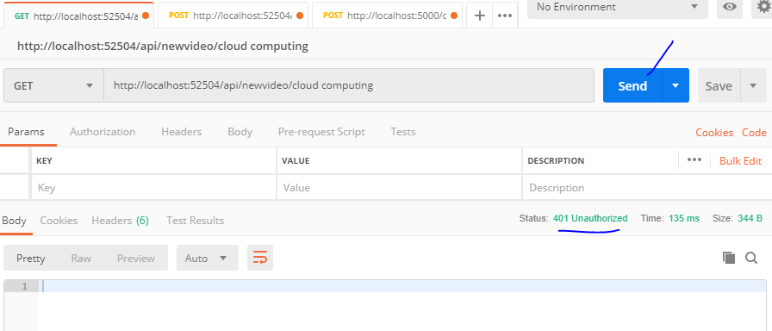

Slide 47
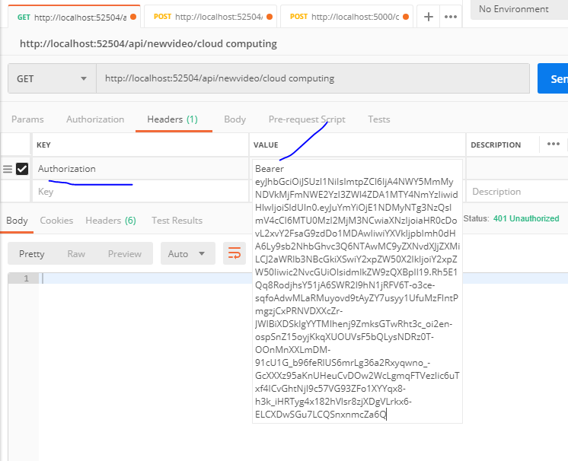
Value will be
Bearer space Token

Slide 48
